Slide 1
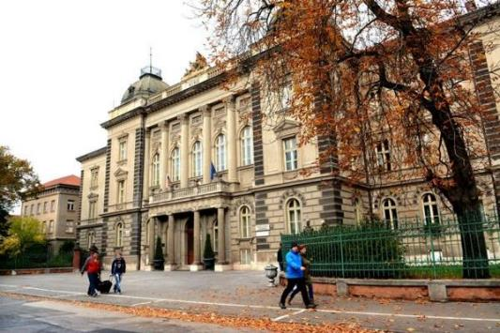
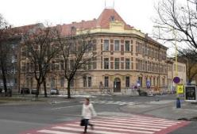
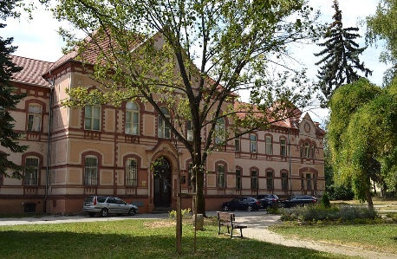
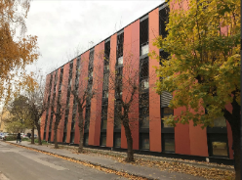


Programming STEAM projects
in Scratch
Ľubomír Šnajder
Pavol Jozef Šafárik in Košice, Slovakia
May, 20th -24th 2019, University of Debrecen, Hungary

Slide 2
Content
About Scratch
Learning Objectives
Conditions for Learning
Sound and music projects
  Motivational
  Bridging programming & musical concepts
  Inquiring pupils’ abilities in perception & making sounds
  Creative
Conclusions

Slide 3
About Scratch
developed & managed by the Lifelong Kindergarten Group at the MIT Media Lab, led by Mitchel Resnick
follower of Logo culture, supporting constructionist approach to learning, “imagine, program, share“
satisfies good properties for programming language for pupils – low-floor, high-ceiling, and wide-walls
online community (http://scratch.mit.edu/), Scratchers can share, discuss and remix their artifacts (interactive stories, games, animations, and simulations) each other

Slide 4
Learning objectives (1)
to understand commands in Scratch for playing sounds, setting and getting sound parameters and to apply them for programming of sound and music projects,
to strengthen basic programming concepts
(e.g. variables, loops, branching, procedures, lists, recursion, concurrent execution of code, broadcasting),
to develop musical skills and creativity of pupils by creation of useful and valuable musical artifacts,

Slide 5
Learning objectives (2)
to develop inquiry skills and understanding of basic concepts of physics, music, languages by development of tools in Scratch for data visualization and audialization,
to learn more about pupils’ abilities in perception and making of sounds and music,
to develop communication and team skills, thanks to publishing, commenting, sharing and remixing projects in Scratch community.

Slide 6
Conditions for Learning (1)
inducing creative, open and pleasurable atmosphere in a class, where pupils can solve their own problems with none or little help from a teacher and discuss freely,
preparing collections of interesting and valuable projects which are suitable for ordinary pupils not only for audio and music enthusiasts,
preparing various types of teaching aids, e.g. motivational video, stories and ready-made projects, half-baked projects, worksheets,

Slide 7
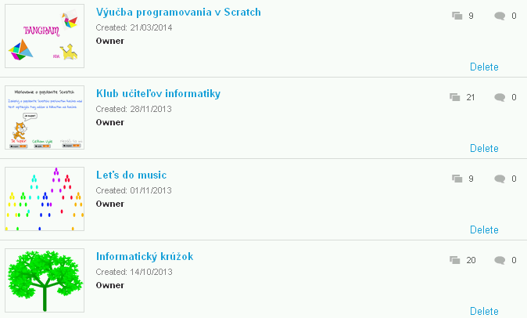
Conditions for Learning (2)
using heuristic dialogues which support pupils’ understanding of subject matter and also their inquiry skills,
establishing of Scratch studios on Scratch portal where teacher and pupils can publish, comment and remix projects with sounds and music.

Slide 8
Sound and music projects
Motivational
Bridging programming & musical concepts
Inquiring pupils’ abilities in perception & making sounds
Creative

Slide 9
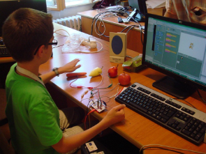
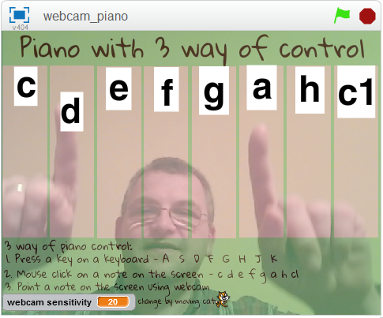
Motivational projects
Animated and musical greetings cards
Jokes and stories
Multimedia dictionary (with Makey-Makey)
Musical instrument
Multimedia visit card
ZOO
Multimedia encyclopedia
of musical instruments
Jukebox

Slide 10
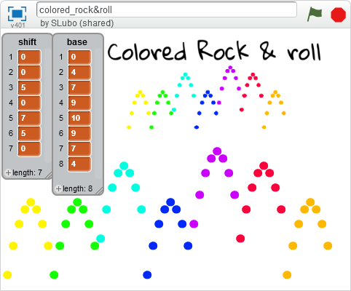
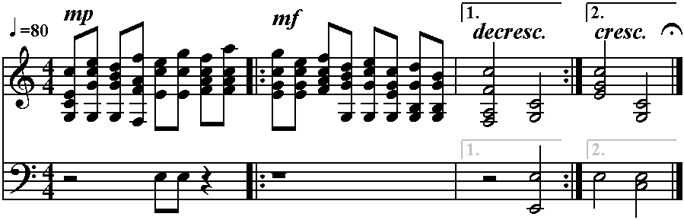
Projects bridging programming & musical concepts
Pairs: playing chords – threads (parallelism), sequences of notes – data structure list,
repetition of notes – loop,
prima/seconda volta – branching,
song refrain – procedure
Jingle – parallelism.
Karaoke of a children song – procedures.
Colored rock-n-roll, visualized own song – loops, lists.
Singing binary tree – recursion.

Slide 11
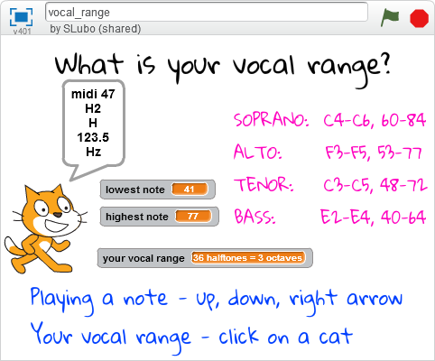
Projects inquiring abilities in perception & making sounds
What is my vocal range?
Vocal warm-up
Sound pexeso
Sound quizzes
Rhythmic clapping game

Slide 12
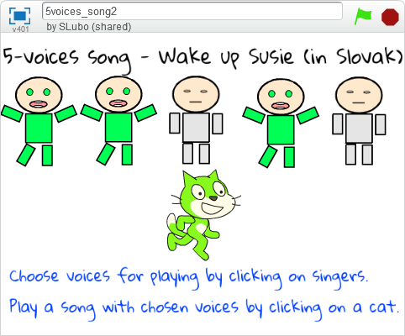
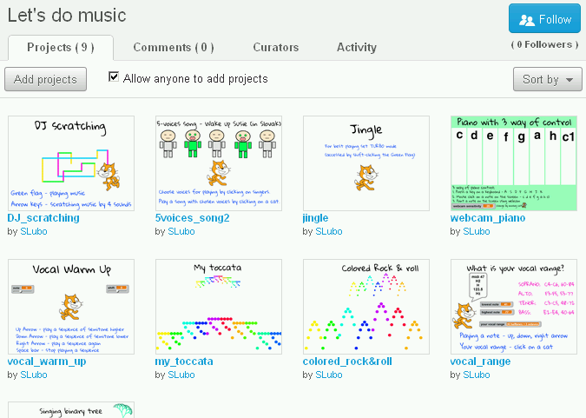
Musical & programming creative projects
5-voices song – song with 5 harmonized voices which can be selected for playing.
Jingle – midi-like composition with 1 leading melody and 3 drums.
DJ – song with 4 scratching sound effects.

Slide 13
Conclusions
Our methodology – not only pure programming, development of musical and programming creativity, connections with physics, music
Constructionistic approach – useful artifacts creation
Online community - learning and living collaboratively
Designing of methodology in design cycles – studying, programming, preparing teaching aids, teaching, discussing and publishing results

Slide 14

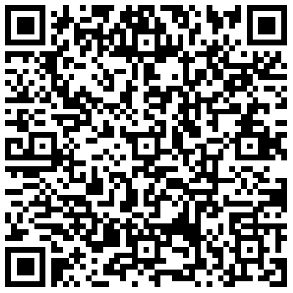
Contact
doc. RNDr. Ľubomír ŠNAJDER, PhD.
lubomir.snajder@upjs.sk
P. J. Šafárik University in Košice
Faculty of Science
Institute of Computer Science
Jesenná 5, 041 54 Košice
SLOVAKIA

