Slide 1
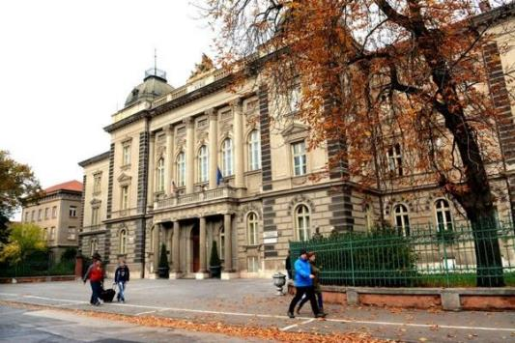
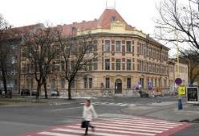
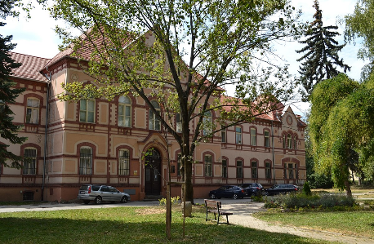
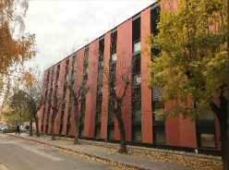

Programming Android mobile devices in MIT App Inventor
Ľubomír Šnajder
Pavol Jozef Šafárik in Košice, Slovakia
May, 20th -24th 2019, University of Debrecen, Hungary

Slide 2
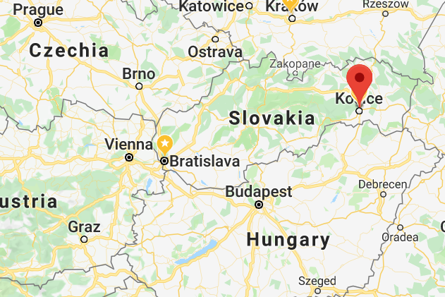
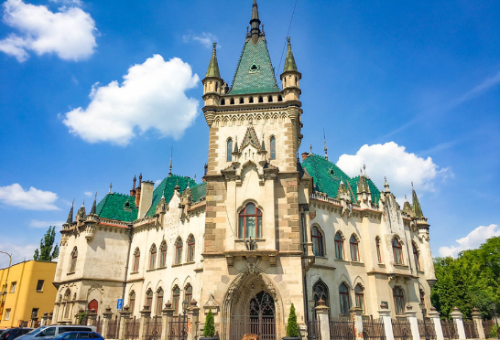
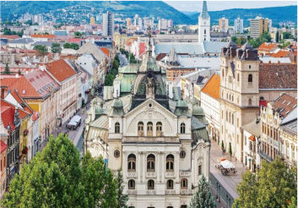
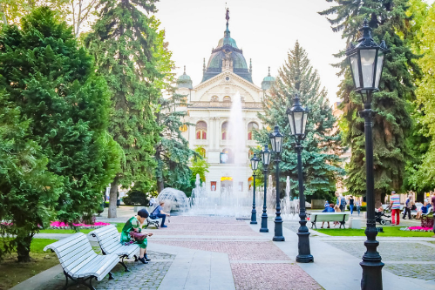
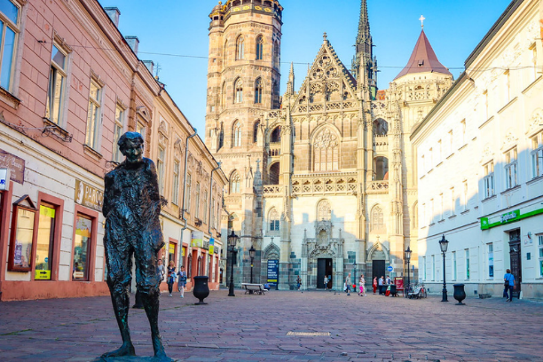
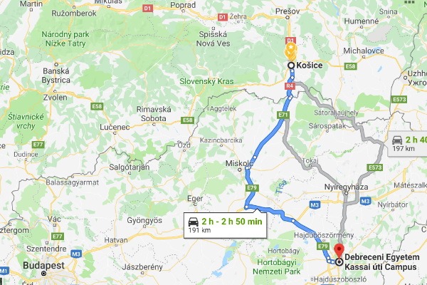

Slide 3
Subject Informatics in Slovakia
Elementary School 1 2 3 4 5 6 7 8 9
Secondary School 10 11 12 13
Topics:
  Representations and Tools
  Algorithmical Problem solving
  Hardware and Software
  Communication and Collaboration
  Informatics Society

Slide 4
Programming in schools
Paradigms (procedural -> event driven, OOP)
Languages (Logo, Pascal -> Scratch. Python)
Devices (PC -> robotics, mobile devices, drones, IoT)
Aims (language constructions -> CT, inquiry skills)
Approaches (traditional -> PBL, IBSE)

Slide 5
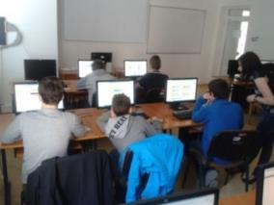
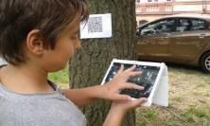
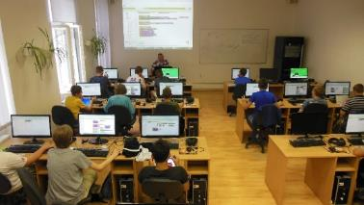
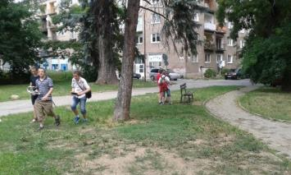
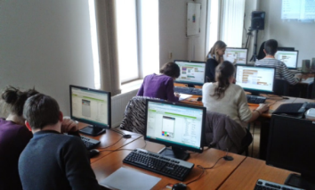
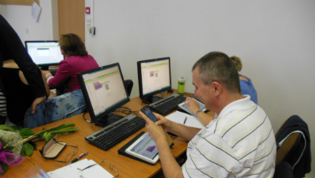
Programming of Mobile Devices
non-formal classes (rings) for K7-K9 (2012-2017)
summer camps for K8 (2015)
Clubs of informatics teachers (2014-)
future informatics teachers – subject
“School programming environments” (2013-)
NPITA – subject “Programming mobile
devices” for secondary schools (2018-)

Slide 6
A model for informatics classes
Problem solving and Programming
Programming of Mobile Devices
Computer Systems and Networks
Information Security
Databases
Object approach to Problem solving
Data creation and Presentation
Programming the Websites

Slide 7
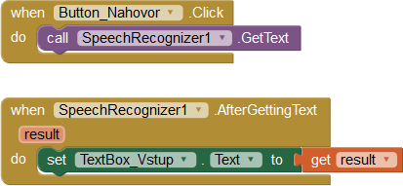
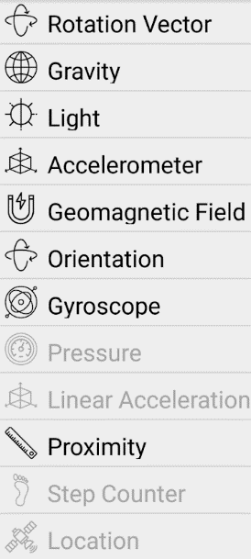




Characteristics of the subject

Slide 8
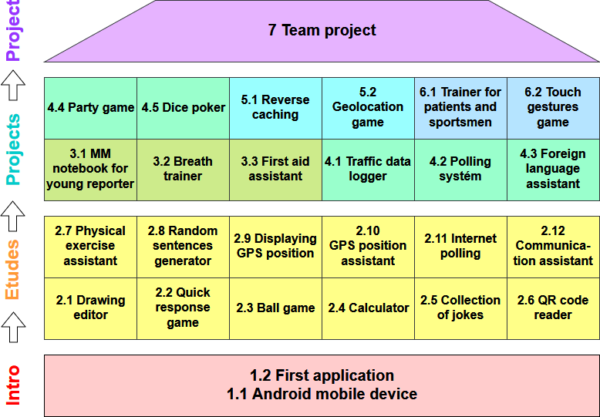

Slide 9
Structure of teaching materials - etudes
Keywords
Cognitive objectives of the chapter
Preparation for teaching
Recommend process of the instruction
List of etudes
Table with mapping tasks to components and language concepts
Collection of 12 etudes
Bibliography
Index

Slide 10
Structure of particular etudes
Learning elements (components, events, methods, properties, language concepts)
List of working files
Commentary on instruction progress
Worksheet with several tasks
Worksheet with tasks' solution
Self-assessment card

Slide 11
Components and language concepts
User Interface: | Language concepts:
Screen, Canvas, Ball, Image Multiple Screens Button, TextBox, Label, CheckBox Horizontal/Vertical/Table Arrangements ListView, ListPicker Slider, Spinner Notifier | Loops Branches, conditions Mathematical operations a functions Global variable (numbers, colors) Lists Procedures, functions Local variables
Sensors: | Communication:
Clock AccelerometerSensor LocationSensor Map OrientationSensor BarcodeScanner ProximitySensor Pedometer | ActivityStarter Texting PhoneCall
Memory: | Multimedia:
TinyDB FireBase | Sound, TextToSpeech SpeechRecognizer

Slide 13
Support for teachers
Teaching materials and aids for pupils
  teaching materials, worksheet with tasks' solutions, source codes of applications
  worksheet with several tasks, self-assessment card, working files, reference materials
Course for teachers (50 hours)
Communication with teachers (LMS Moodle)
  questionnaire for teachers (feedback after lessons)
  pupils’ applications
  discussion forums

Slide 14
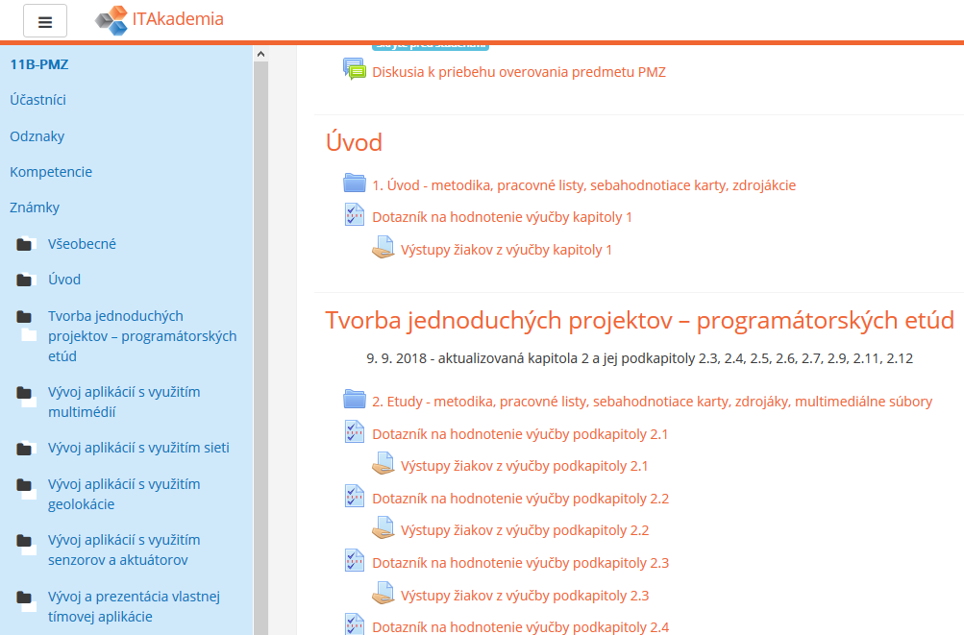
Verifying and reviewing of the subject
LMS Moodle
discussion forum
teaching material
worksheets
working files
self-assessment
questionaires
pupils' outputs

Slide 15
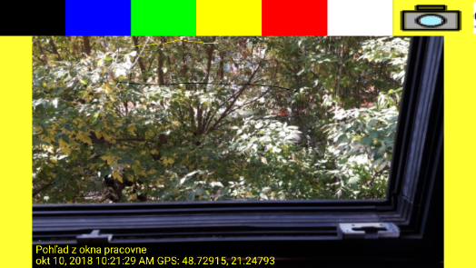
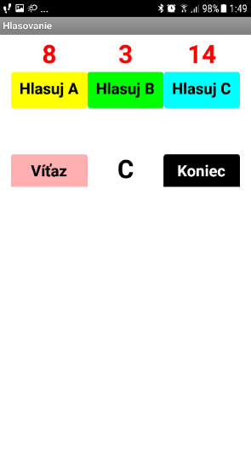
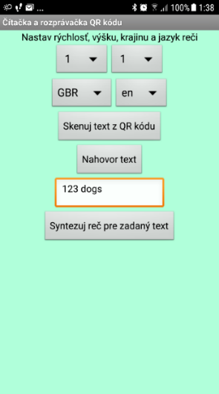
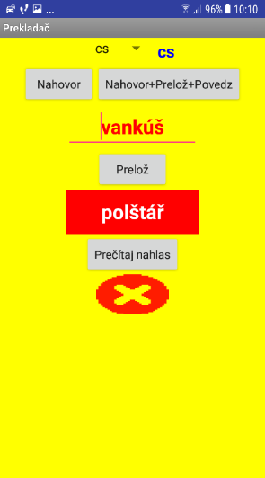
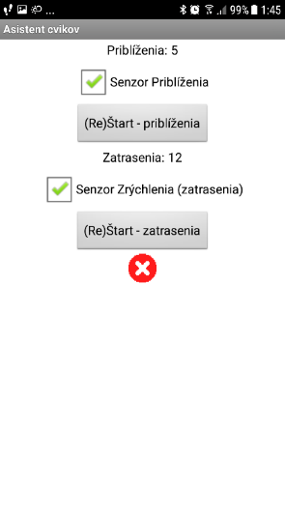
Samples of etudes

Slide 16
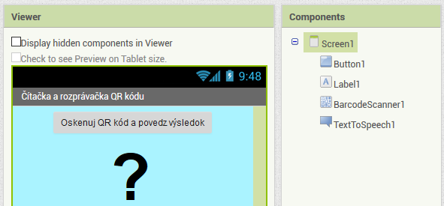
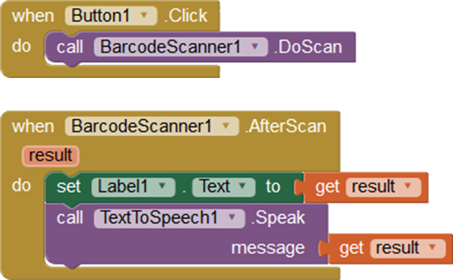
QR code reader

Slide 17
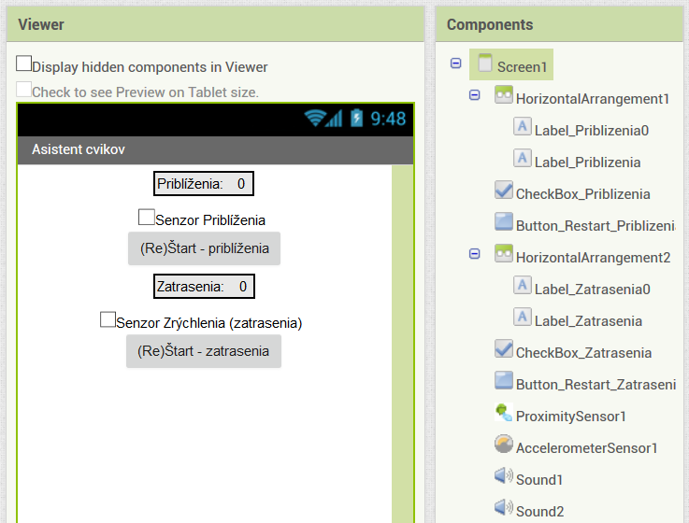
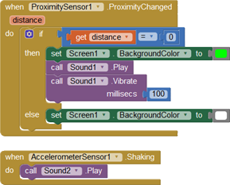
Physical exercise assistant

Slide 18
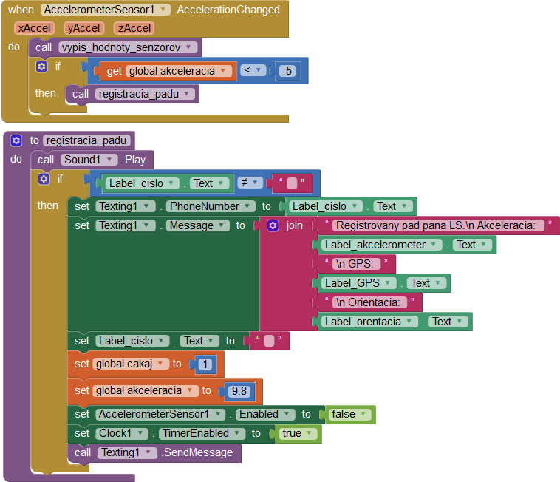
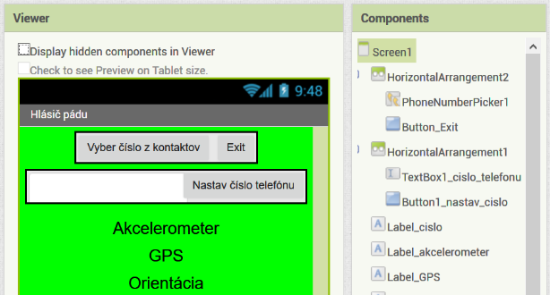
Alarm for seniors' falls

Slide 19
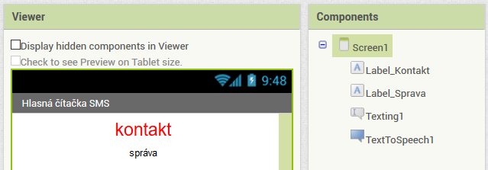
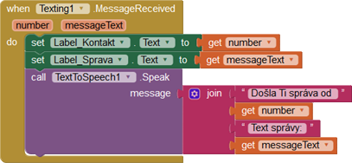
SMS reader

Slide 20
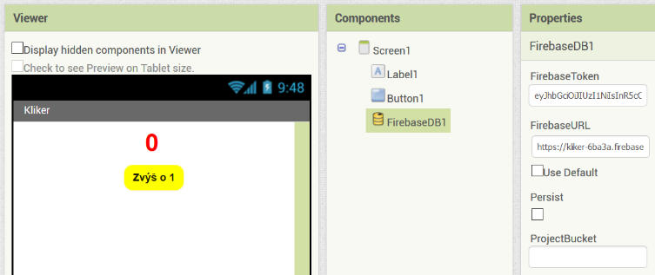
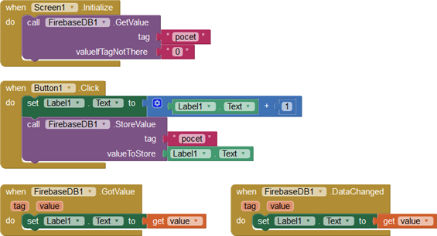
Internet polling

Slide 21
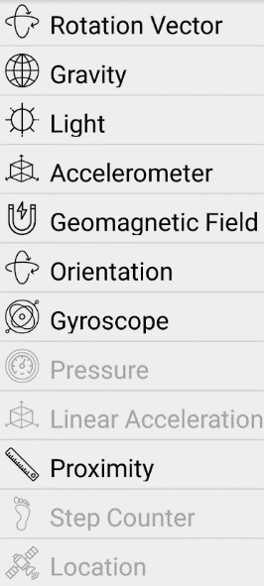


Acknowledgements
Projects: NPITA, KEGA 029UKF-4/2018
Secondary school teachers (verifiers), IT consultants

Slide 22

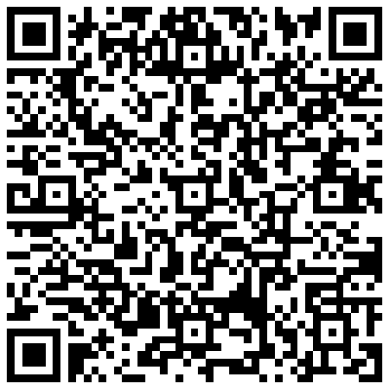
Contact
doc. RNDr. Ľubomír ŠNAJDER, PhD.
lubomir.snajder@upjs.sk
P. J. Šafárik University in Košice
Faculty of Science
Institute of Computer Science
Jesenná 5, 041 54 Košice
SLOVAKIA

