Slide 1
Programming of STEM mobile applications in formal and informal education
Ľubomír Šnajder – Ján Guniš
P. J. Šafárik University in Košice, Faculty of Science, Slovakia

Slide 2
Content
Methodology of teaching of mobile applications programming in AI2
Programming of STEM applications
Using mobile devices in education
Data logger for the city traffic
Pedometer or physical activities counter
Suggestions for further projects
Conclusions

Slide 3
Methodology of teaching of mobile applications programming in AI2
sources: Constructionism + Inquiry Based Learning
inspiration: Build – Conceptualize – Customize – Create (Wolber’s model of teaching)
main attributes of our methodology:
creation useful apps exploiting spec functionalities of MD (touch, sensors, MM, speech, phone, SMS, run other apps)
first introduce sensors, then program constructions
pupils follow worksheets with formative assessment
rapid app creation -> extension to (STEM) project
support for teachers (methodologies, training)

Slide 4
Using mobile devices in education
Communication
Multimedia
Games, leisure ...
Data processing:
spreadsheet -> spreadsheet on a cloud, MD
fictive data -> real data
data from external sources -> original and authentic data
not only process data -> obtain data + process data
using sensors of MD

Slide 5
Data logger for the city traffic (1)
motivation
real, original data for spreadsheet,
mobile devices, GPS module …
data stored directly in electronic form,
research problem
traffic in the city – traffic density
typical STEM project
Programmer problem – to create mobile application
Scientific problem – to process data statistically

Slide 6
Data logger for the city traffic (2)
Problem analyses
What type of data is recorded and how to record data?
Which data can be obtained automatically and which require the decision of man?
What is the format of recorded data?
Where will be the data stored?
What functionality and interface should the application have?
Which environment (language) will be used to create the application? (We assume AI2)
Which previous decisions can we implement within the given environment? How to modify those we cannot implement?

Slide 7
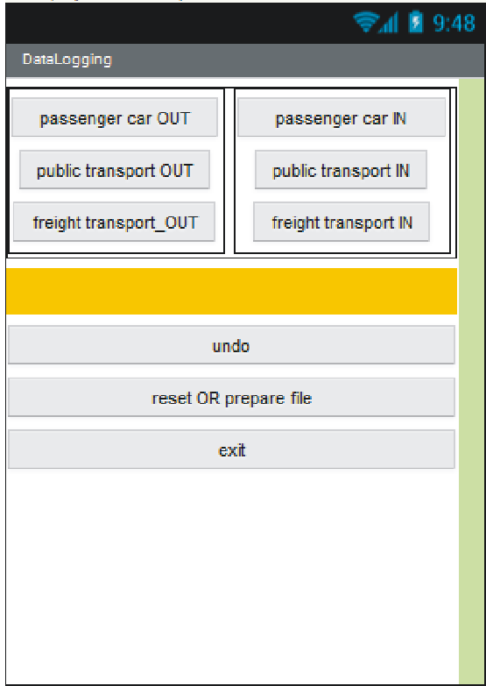
Data logger for the city traffic (3)
Possible answers
Programming environment MIT App Inventor 2
Data will be stored in the local CSV file
data | value | automatically / decision researcher
place of measuring | GPS receiver | automatically
time of measuring | system time | automatically
direction of car | in city, out of city | decision researcher
type of transport | passenger car, public transport or freight transport | decision researcher

Slide 8
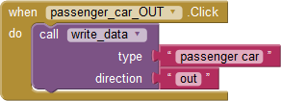
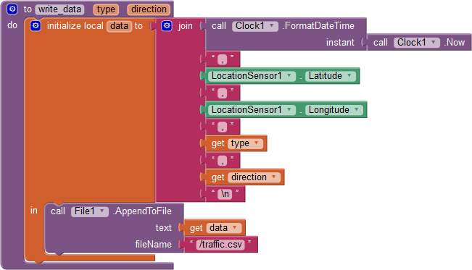
Data logger for the city traffic (4)
Part of program code

Slide 9
Data logger for the city traffic (5)
Programming is beauty – because each product provides a room for improvement.
Problem 1: We do not have feedback when a button is pressed.
solution: short vibration
Problem 2: Which button was pressed?
solution: View just stored data in label component
Problems: UNDO action, reset data, data from more observers
…

Slide 10
Pedometer / phys. activities counter (IBL, requirements-means)
guided inquiry (problem, methods, result)
requirements for mobile app (problem) –> means (AI2):
what sensors are suitable for recording of movement speed changes (apps from Google Play)
identify movement speed changes (accelerometer components, AI2 cmds)
display value of accelerometer sensor (write/draw cmds)
steps counting (calculation, testing cmds)
keep measured data (store to/read from file cmds)

Slide 11
Pedometer / phys. activities counter (sequence of questions)
How much the values of various sensors of MD in the same situations differ?
What trends have the components of acceleration measured by the sensor during walking? How much do they differ for different types of gait and a variety of people? Which of the components of acceleration will be taken into account?
At what place and in what position we should fasten the mobile device to the human body to obtain the most accurate values from mobile application to measure the number of steps?

Slide 12
Pedometer / phys. activities counter (sequence of questions 2)
Which algorithm should we use to calculate the steps? We calculate the steps immediately, or from recorded values?
What other functionalities should the mobile application have?
What other useful applications can be derived from this pedometer application?

Slide 13
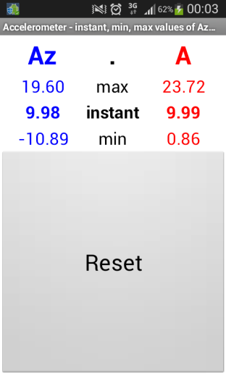
Pedometer / phys. activities counter (methodology)
Determining what sensors are on our MD and how they react on changing the speed of movement (accelerometer sensor is a winner)
Programming mobile app (in AI2) for displaying actual value of acceleration sensor (z-component)

Slide 14
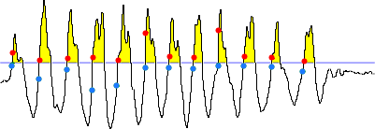
Pedometer / phys. activities counter (methodology 2)
Experimenting with our and other ready-made apps during walking (periodic course of accelerometer sensor). Number of steps = number of passes through the certain threshold.

Slide 15
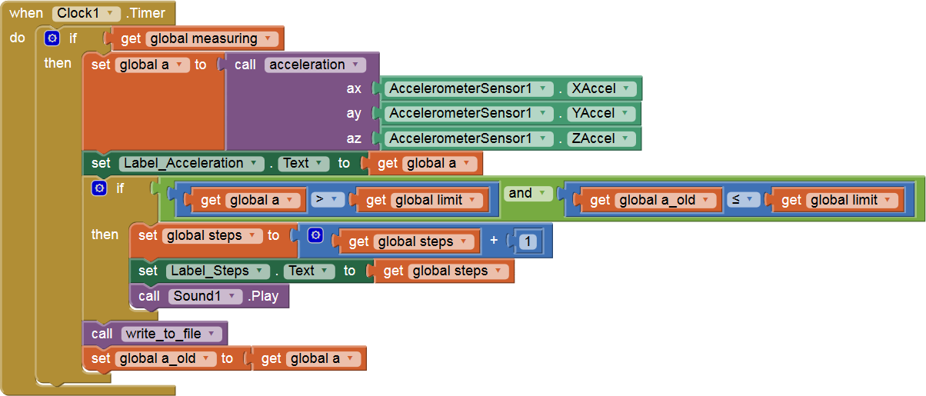
Pedometer / phys. activities counter (methodology 3)
key part of program code with absolute value of the acceleration vector $\sqrt{a_{x}^{2}+a_{y}^{2}+a_{z}^{2}}$

Slide 16
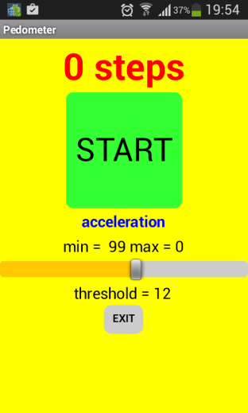
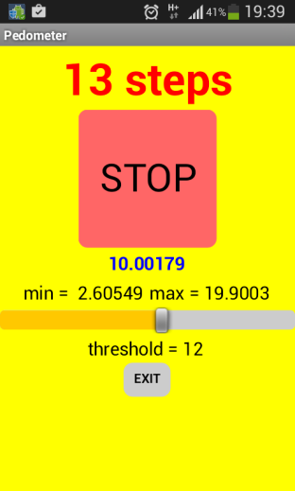
Pedometer / phys. activities counter (methodology 4)
Adding other features:
setting sensitivity threshold of the pedometer
recording (and displaying) of measured data to a text file
delay before measuring
http://ai2.appinventor.mit.edu/?galleryId=6283550952259584

Slide 17
Pedometer / phys. activities counter (methodology 5)
Creation of other apps based on pedometer:
counting of squats
determine the pace of selected training exercises
diagnosing of pathological shakiness, or lameness

Slide 18
Suggestions for further projects
Multimedia notepad for young journalists (taking photos with recorded date, time, GPS position, personal notes and additional drawings).
Talking compass for visually impaired persons (orientation sensor, speech synthesis)
SMS loud reader for visually impaired or very busy persons (using speech synthesis, receiving SMS)
Detector of falls for seniors (sending SMS to specified person with recorded information about GPS position, orientation and time of a fall)

Slide 19
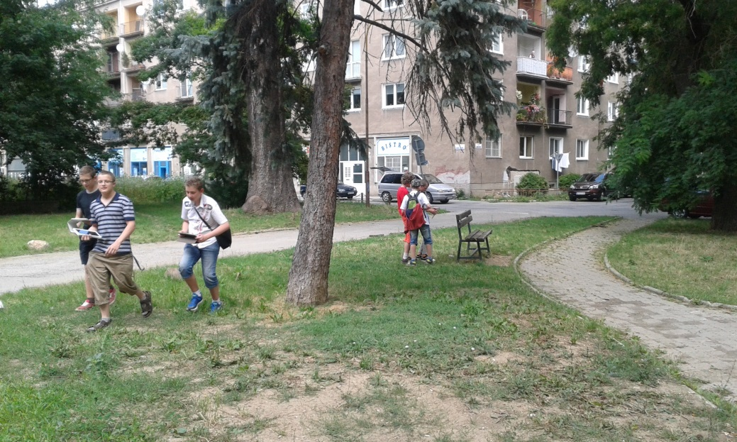
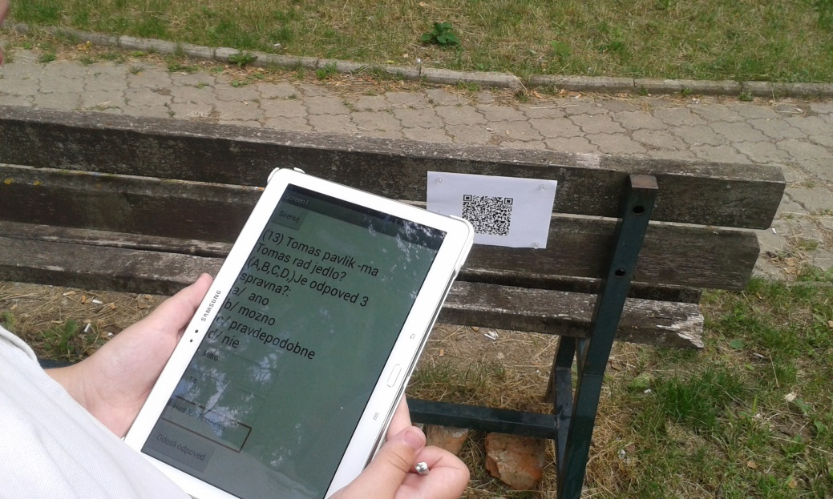
Suggestions for further projects 2
Treasure hunting game (GPS sensor, orientation sensor, barcode reader).

Slide 20
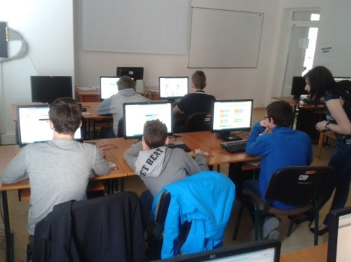
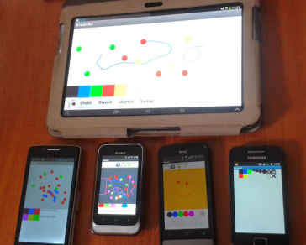
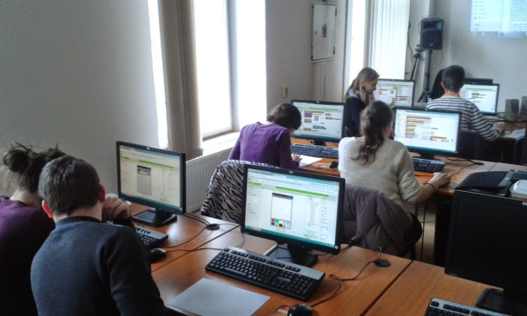
Conclusions
examples of meaningful integration of MD into educ. – exploiting and creation own mobile apps
pupils – programming, STEM, inquiry skills, creativity (formal educ., IT ring/camp)
prepared (future) teachers – methodologies, training
future plans – development methodologies, writing book for pupils on programming in AI2
supported by the Slovak Research and Development Agency under the contract no. APVV-0715-12 Research on the efficiency of innovative teaching methods in mathematics, physics and informatics education.

Slide 21
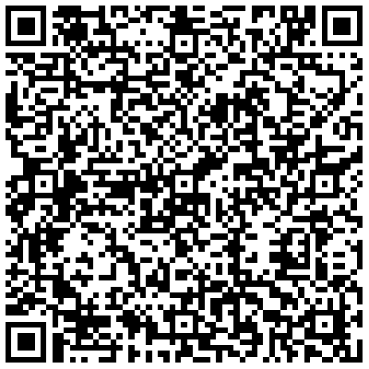
Contacts
RNDr. Ľubomír ŠNAJDER, PhD. lubomir.snajder@upjs.sk
PaedDr. Ján Guniš, PhD. jan.gunis@upjs.sk
Pavol Jozef Šafárik University in Košice Faculty of Science Institute of Computer Science Park Angelinum 9, 041 54 Košice Phone (office): 00421 55 234 2539 GPS: 48.728888 N, 21.248232 E

